Slide 1
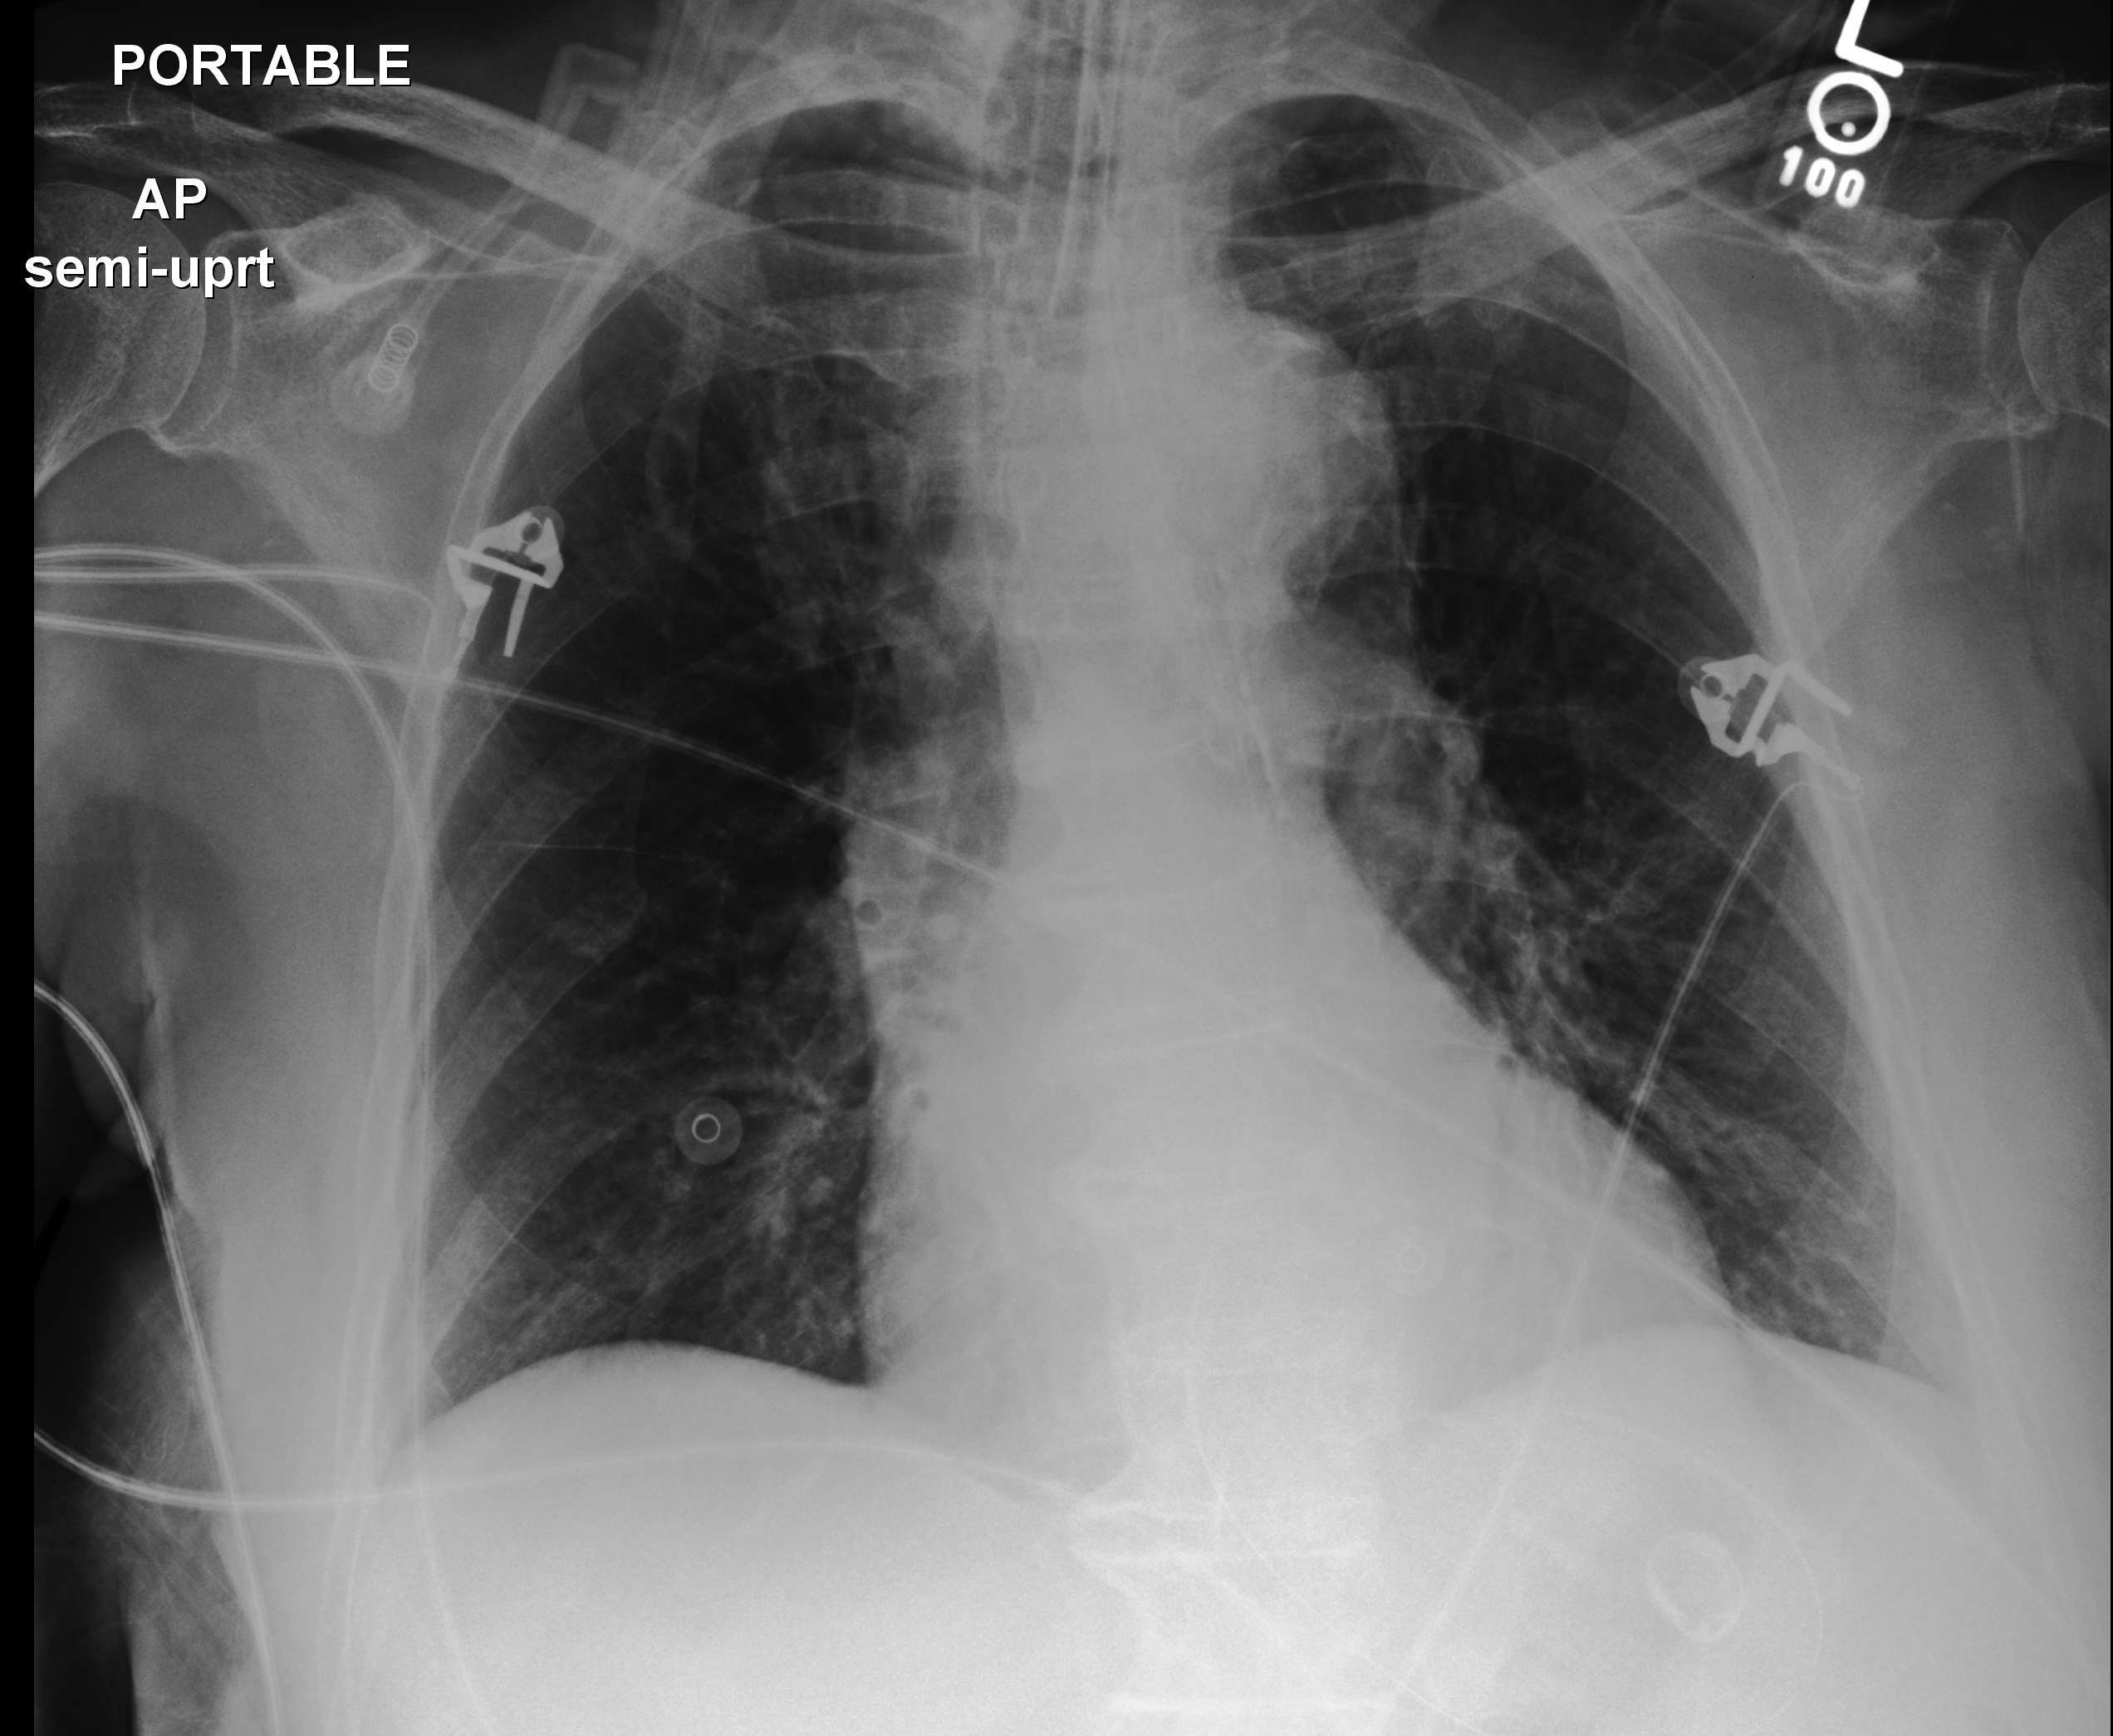
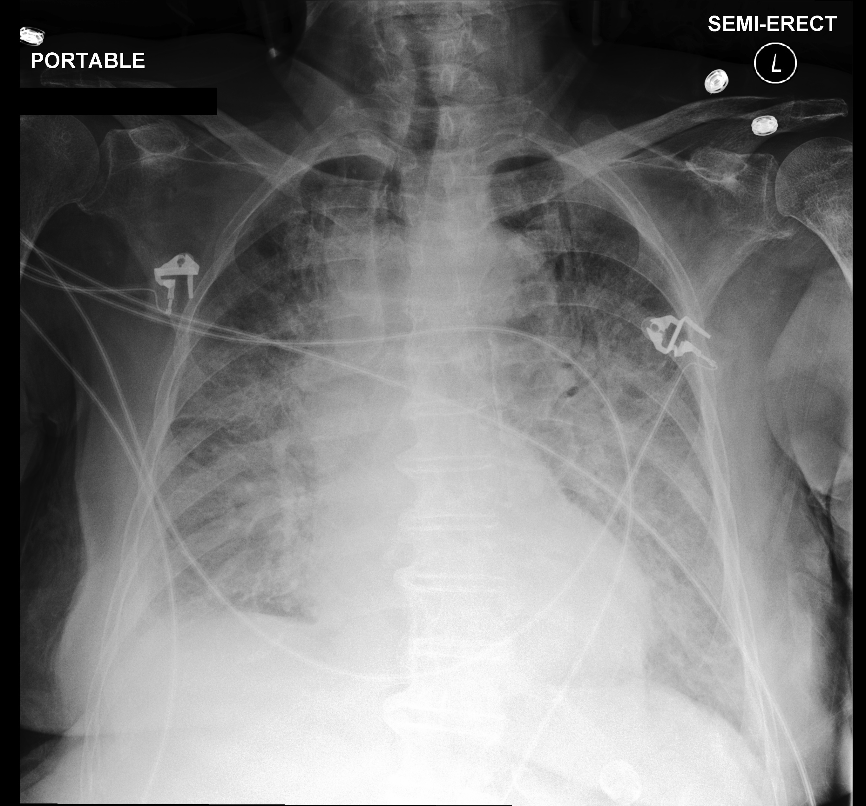
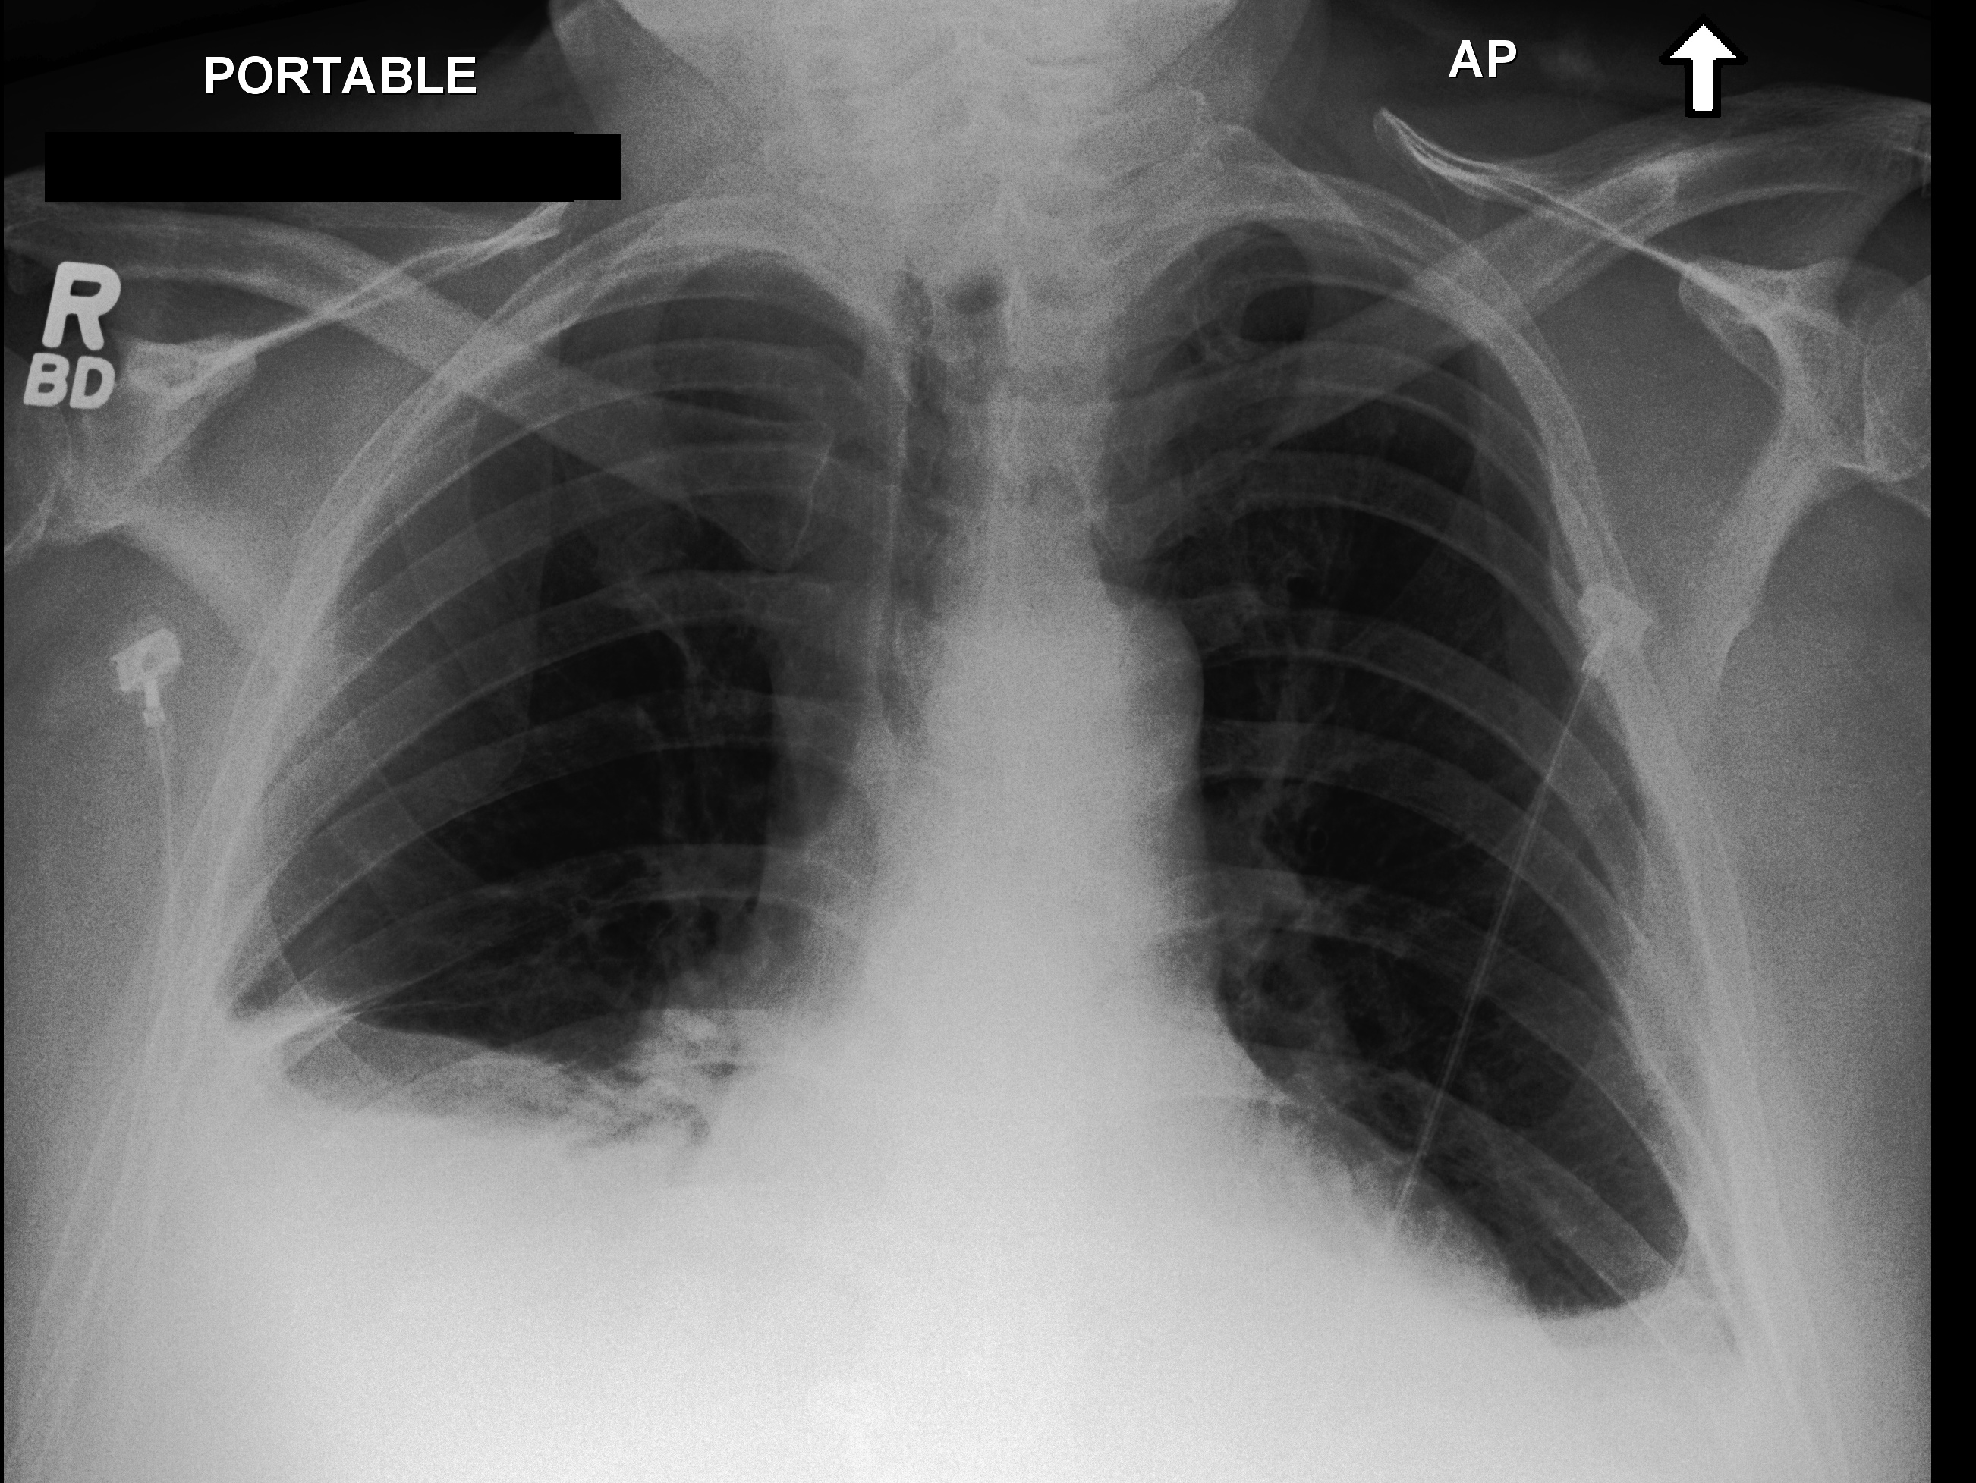
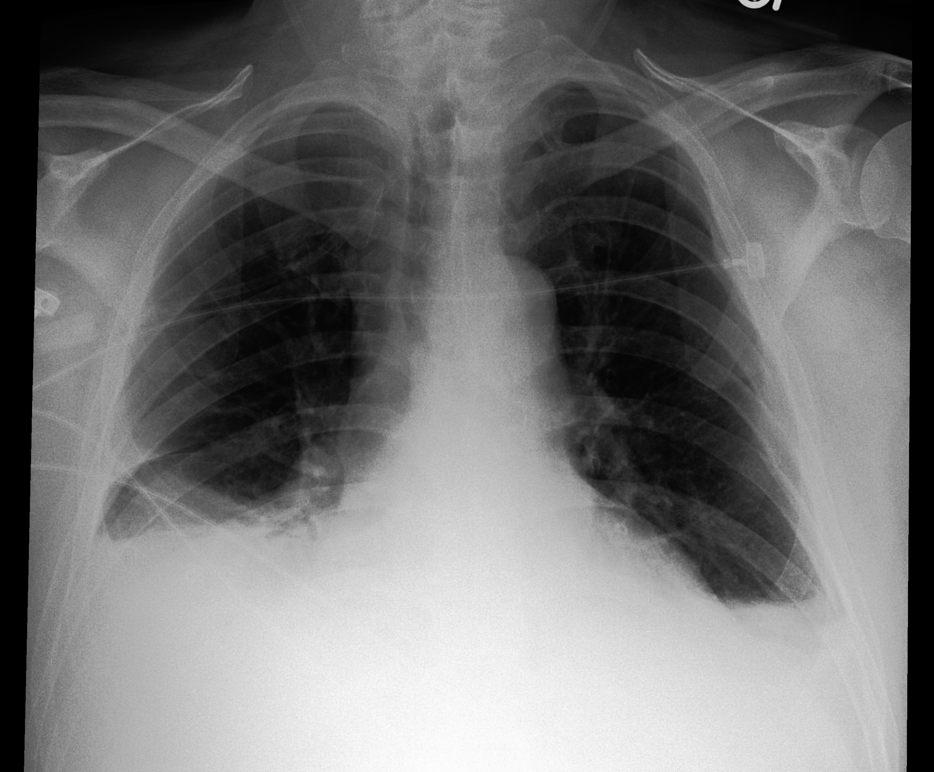
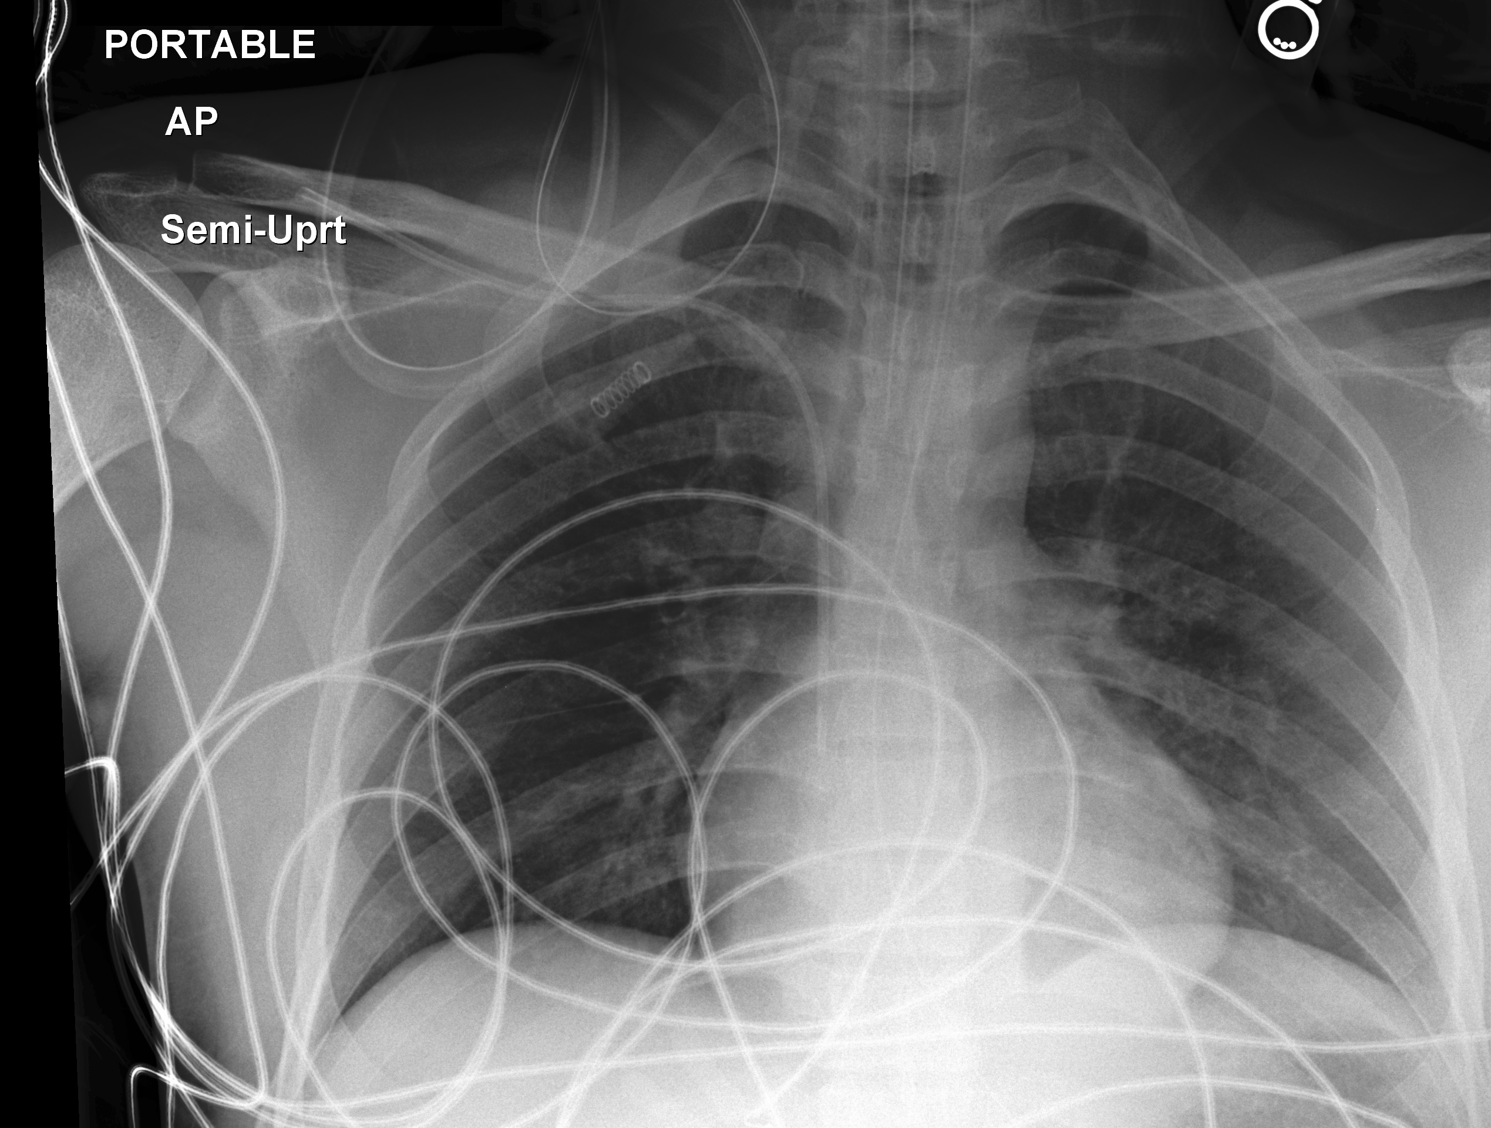
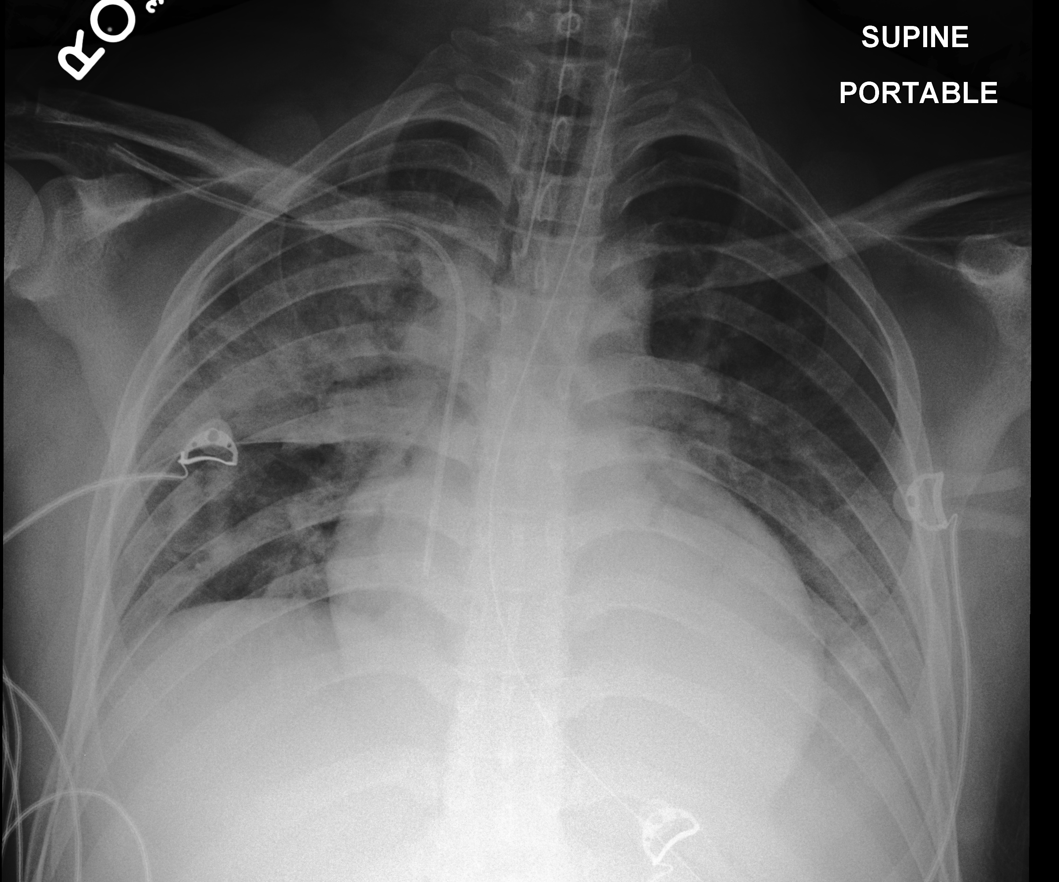
Representative longitudinal MIMIC trajectories used by MedWorld-JEPA
Current chest radiograph evidence is paired with one observed future study;
linked MIMIC-IV records provide retrospective audit context for the interval.
1
Current evidence at t
2
Linked retrospective context — not model input
3
Observed follow-up target t+
Case A
Horizon bin (model context)
Exact elapsed time
• marked bilateral
opacity / edema
• small right pleural
effusion
• infectious-appearing
diffuse process
clear change
0–24 h
20.1 h
(observed, not input)
Care setting:
SICU
Linked retrospective context (MIMIC-IV) — not model input
no edema /
effusion /
pneumonia
reported
Ventilation
Imaging
Lines
IV medications
mechanical
ventilation
prior CXRs,
CT chest
central line,
arterial line
diuretics,
antibiotics
Support-device
difference
present
These records are retrospective audit context for the interval, not causal.
Case B
Horizon bin (model context)
Exact elapsed time
• bibasal
opacification
• pleural
effusions
• compressive
atelectasis
stable follow-up
0–24 h
≈24.0 h
(observed, not input)
Care setting:
SICU
Linked retrospective context (MIMIC-IV) — not model input
bibasal
opacification
pleural
effusions
compressive
atelectasis
Lines
IV medications
central line,
PICC
vasopressors,
antimicrobials
stable
follow-up
These records are retrospective audit context for the interval, not causal.
Case C
Horizon bin (model context)
Exact elapsed time
• new bilateral
parenchymal
opacities
• right upper lung
most severe
• probable
multifocal
pneumonia
• possible pleural
effusion
clear change
24–72 h
50.5 h
(observed, not input)
Care setting:
trauma SICU
Linked retrospective context (MIMIC-IV) — not model input
no focal opacity
or pleural
effusion
Ventilation
Imaging
Cultures
Lines
IV medications
Support-device
difference
present
mechanical
ventilation
serial CXRs,
CT scans
blood, sputum,
respiratory
central line,
PICC
broad-spectrum
antibiotics
These records are retrospective audit context for the interval, not causal.
Each follow-up is one observed future, not the only possible future. Report-derived findings are weak evaluation labels. Post-current clinical events are retrospective and non-causal.

